Slide 1
Financial Markets and Securities Investment Management Process
Notes:
Introduction:

Slide 2
Investment Process
Notes:
Specify objectives and identify the constraints. Objectives will determine the risk return tradeoff, constraints include items like planned cash withdrawals and risk tolerance.
Formulate an investment policy: this one is summarized in Table 22.2 on the next page
Monitor performance and then reevaluate and modify portfolio as determined from monitoring. Have to update

Slide 3
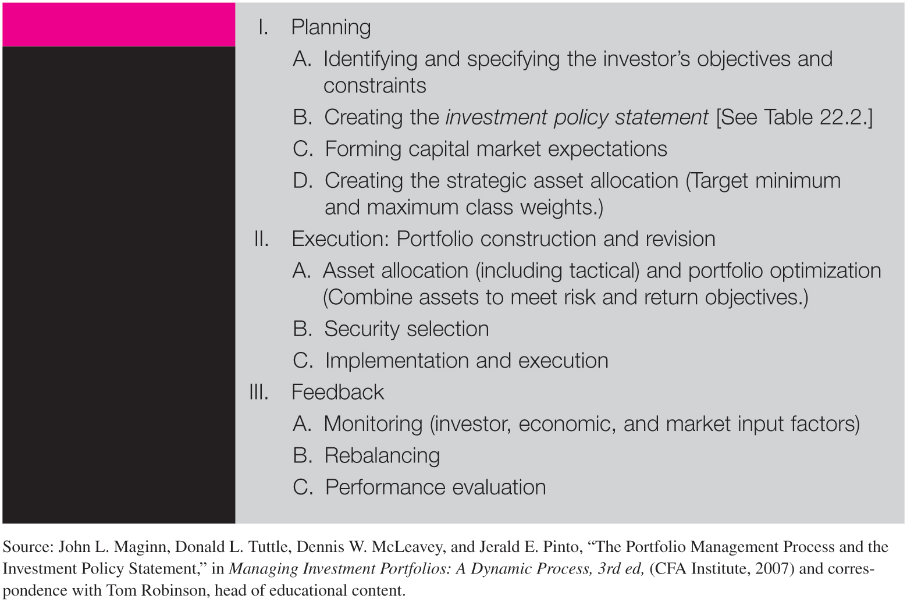
Overview of Inv. Process

Slide 4
Investor Objectives

Slide 5
Spec Objectives: Individuals
Balance risk and return throughout your life
As you age your wealth shifts from human capital to financial capital, increasing the importance of portfolio choice.
Life Cycle is critical to the process of determining the risk/return trade-off
Younger investors
Willing to bear more risk for higher returns
Older investors
Willing to accept lower returns for lower risk
Notes:
It is not that long term investments are less risky, they are not. Rather young people have time to recover from periods of poor performance and can choose to work more and save more if need be.

Slide 6
Professional Investors
Personal Trusts
An interest in an asset held by a trustee for the benefit of another person.
Management is subject to prudent investor rules
Mutual Funds
Varies with type of fund
Detailed in the prospectus
Notes:
Mutual funds are very competitive and many have evolved to meet certain niches such as income funds, growth funds, sector funds, etc. Under the Investment Company Act of 1940 mutual funds must invest according to the goals in the prospectus.

Slide 7
Professional Investors (cont.)
Pension Funds
Defined benefit: Retirement benefit depends on years with the firm and salary. Investment risk is borne by the company.
Defined contribution: Employee and employer contribute a set amount to the individual’s retirement fund, but retirement benefit depends on investment performance. Investment risk is borne by the individual.
Endowment Funds
Gifts to nonprofits that are invested
Funds from the endowment used by the nonprofit

Slide 8
Insurance Companies
Life Insurance Companies
Term insurance,
Whole life policies (insurance + savings at fixed rate)
Variations of the two with variable rate savings,
Investments are set up as hedges against potential claims of policy holders.
Non-Life Insurance Companies
Invest premiums not paid back to policyholders for losses,
Hedge against potential claims
Notes:
A couple of points may be worth noting here. First, life insurance claims are more predictable than non-Life insurance companies and this allows life insurers to take on more risk in their portfolio. Second, the insurance policies with the savings features generally have high fees and expense. Most individuals would be better served to buy term and invest the difference. Those without the discipline to invest enough may prefer the life insurance plans with the forced savings features.

Slide 9
Banks
Sources of funds: predominantly deposits and some borrowed funds
Investment of funds: predominately in loans and fixed income securities
Active in the securitized loan and asset markets
Not active in equity
Notes:
Banks are prohibited from holding equity for their own account although they may do so through investment banking.

Slide 10
Investor Constraints

Slide 11
Investor Constraints
Liquidity:
Speed and ease with which asset can be converted into cash
Need for cash on short notice increases liquidity requirement, normally entails sacrifice in return
Investment Horizon
The planned liquidation date
Affects portfolio risk and security maturity dates

Slide 12
Investor Constraints
Regulations
Specific regulations that may apply to institutional investors
For example, mutual funds may not hold more than 5% of the stock of any publicly traded corporation.
Any legal trading limitation (country, investor type, etc)
Tax Considerations
Special considerations related to tax position of the investor
Unique Needs
Special considerations related to the underlying investors
Ethical issues
Speculation vs. Hedging

Slide 13
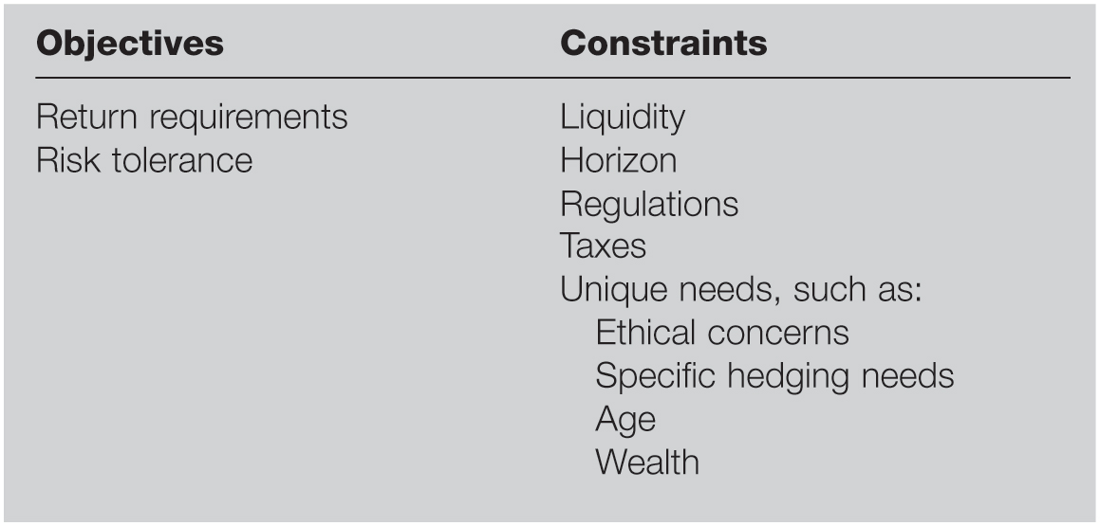
Determination of Portfolio Policies

Slide 14
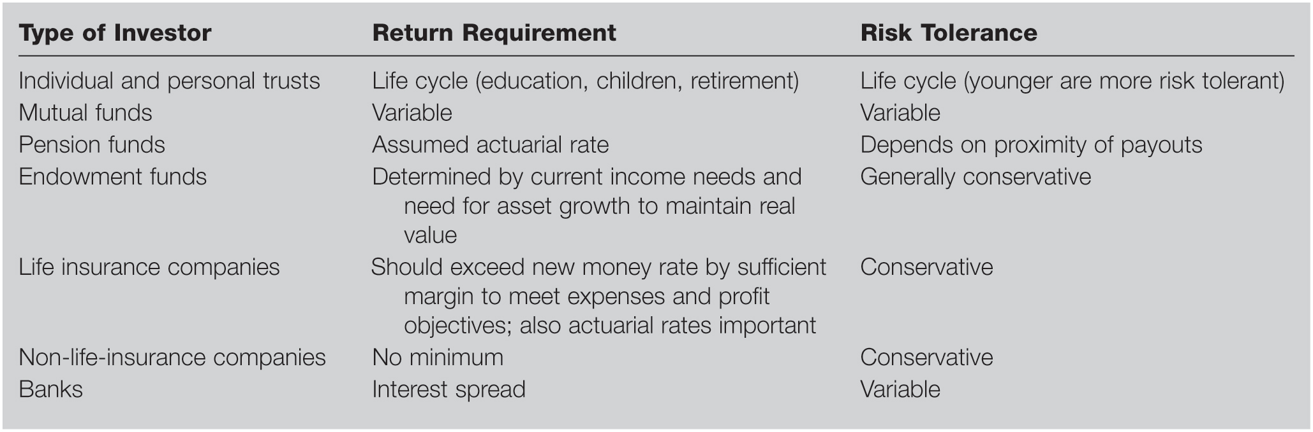
Matrix of Objectives

Slide 15
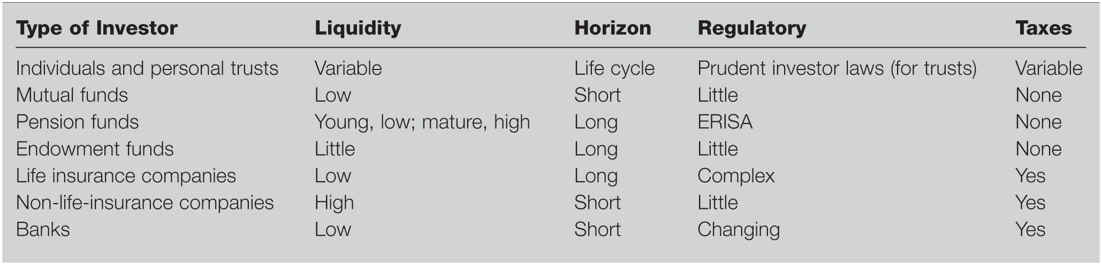
Matrix of Constraints

Slide 16
Investment Policies

Slide 17
Asset Allocation Decision
First decision is Asset Allocation Decision
Money market assets
Based on liquidity needs and to gain more diversification
Fixed-income securities
Primarily bonds, gain diversification and safety with higher real return than in money market
Stocks
Value vs growth,
Large vs small,
Sector weights,
Dividend vs capital gains.

Slide 18
Asset Allocation Decision
Real estate
REITs
Direct holdings
Precious metals and other commodities
Difficult to predict value, no cash flow
Choices will be determined by
Capital market expectations
Risk tolerance, return expectations
Financial needs
Notes:
More conservative the approach the higher the weight in bonds and cash equivalents

Slide 19
Top-Down Policy for Institutional Investors
Investment Committee
Comprised of senior management, formulates investment policies and verifies that they are carried out,
Establishes the asset universe, which is the approved list of assets in which the company’s portfolios may invest,
Formulates broad asset allocation decisions.

Slide 20
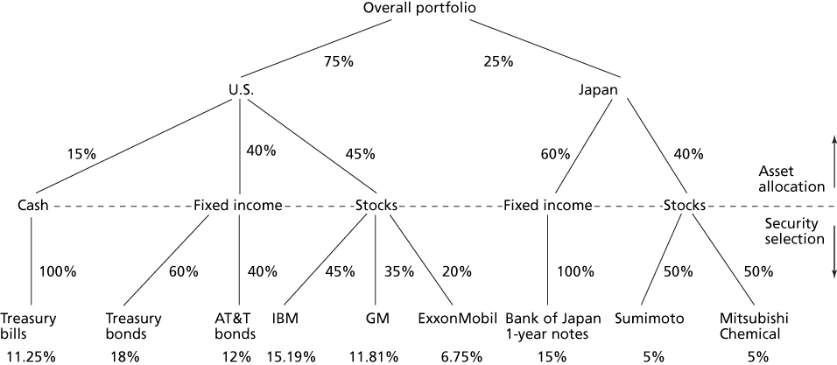
Asset Allocation and Security Selection

Slide 21
Active or Passive
Active
Trying to secure better than average performance
Active asset allocation
Active security selection
Must balance likelihood of better returns with costs in highly competitive markets.
Passive
Trying to get average returns rather than do better than the market
Mix of Passive and Active (Passive core, active part)
Notes:
Asset allocation may involve major moves in and out of the risky portfolio or may involve changing sector weightings according to a forecast or a combination of the two.
Some funds employ a mix of passive and active strategies, maintaining a passive core portfolio with an active component. For this strategy the Treynor-Black model will be very appropriate.

Slide 22
Monitoring and Revising Investment Portfolios

Slide 23
Monitoring and Revising
By the time of completion of investment steps, inputs may be out of date, necessitating strategy revisions,
Client circumstances can change over time,
Portfolio weights will change over time as prices change,
Asset allocation will change over time,
Investing is a dynamic process that must be updated and revaluated
Notes:
This is part of the feedback process mentioned in Table 22.1 and Figure 22.1.

Slide 24
Thank you for the attention!
Any Questions?

